Slide 1
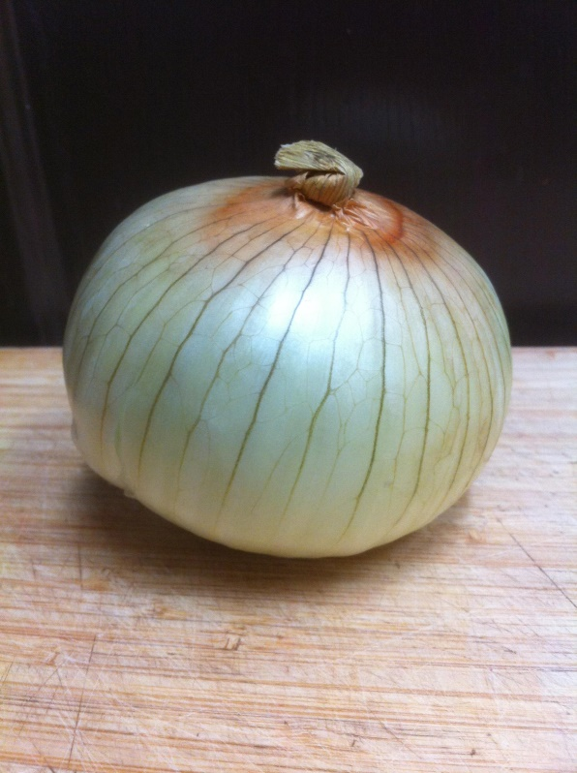
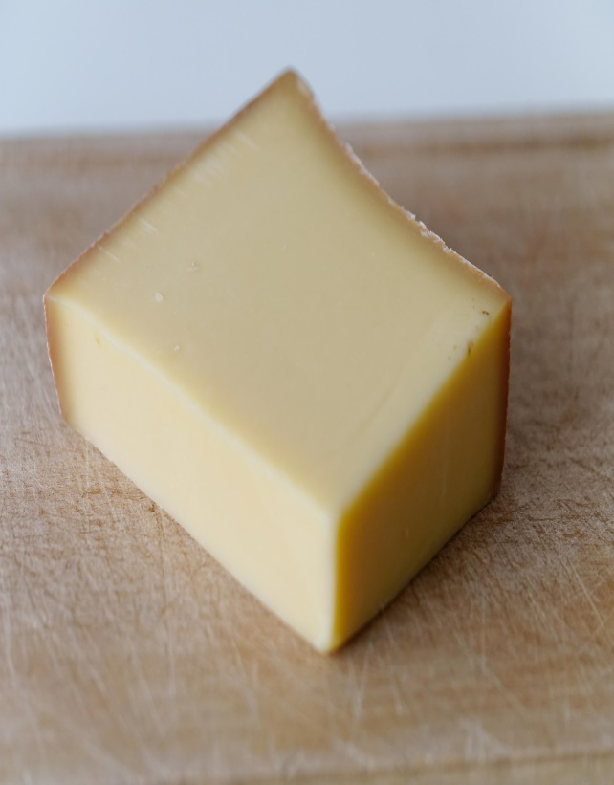
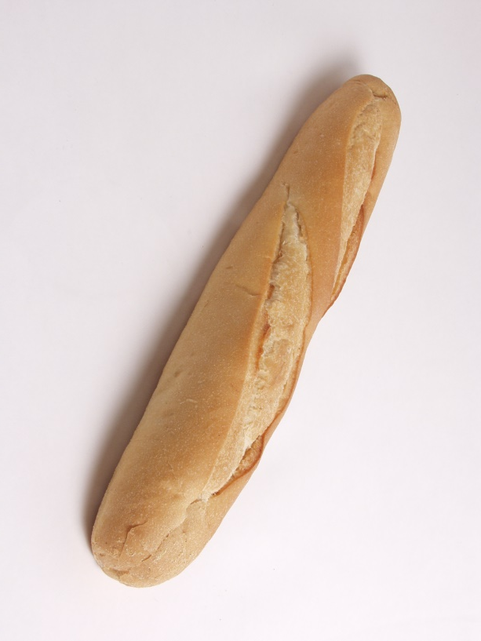
Soupe à L’Oignon
Notes:
Hi, and welcome to the Science Kitchen. Today we are making soup, not just any soup, but onion soup, that’s French onion soup.

Slide 2

Notes:
Before we get started would be great if all of you would send me a selfie. Send it to facebook.com/thesciencekitchen - all one word - and then in a few minutes we can introduce ourselves. Don’t worry if you don’t have facebook. You can send me a picture by e-mail. Send it to RwhatU8@gmail.com

Slide 3
The Science Kitchen
- Food & Cooking as an
- Anchor Scenario for
- Science Education.
Notes:
Here in the science kitchen we use food and cooking as an anchor scenario for science education. Today we’re using a simple recipe for French onion soup with its four ingredients to show you how to do that. We have created four modules that illustrate many scientific principles as related to cooking French onion soup. In today’s module, called “It’s Classified,” we will show you how to apply various different classifications systems to choosing the onion for your soup. Let’s begin by looking at the whole recipe and getting a taste - so to speak - for what”s yet to come.

Slide 4


Notes:
Play Video… So you can see that French onion soup is pretty easy to make; this video was about 3 minutes long. Making French onion soup gives you the opportunity to innovate. The recipe is fairly straightforward, but it can be changed 1000 ways. It really easy to take this recipe and make your own; it calls for four ingredients: onion, broth, bread and cheese. This soup was commonly eaten by the French during the German occupation in world war two. It’s perfect because it uses inexpensive ingredients and you can change the quantity and quality of them and still have a tasty meal.

Slide 5
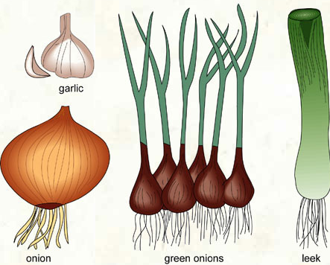
Learning Outcomes
Choose onions for soup.
Differentiate between different kinds of culinary Alliums.
Categorize different kinds of Onion Varieties by function and by morphology..
Relate the source of the word onion vis-à-vis its’ growth habit.
Name onion plant parts gross anatomy.
Classify onion taxonomically.
Notes:
So just what are we going to talk about today? First off, I’ll help you choose your onions for your soup. In order to do that, you have to know little bit about the onions. So we’re going to learn to differentiate between the different kinds of culinary alliums. What are alliums? “Alliums” is the genius of the onion family. It’s the Latin name; we will talk a bit about taxonomy and the genus and species names given to plants. We’re looking at the different kinds of onions, so we’re going to categorize them by function and morphology. Morphology means how they look - what they’re made of - their different parts. We are also going to learn the source of the word onion and how it relates to the way onions grow.

Slide 6



Getting to Know You.
Notes:
I’ve collected your photos from my e-mail and posted them to facebook with the others. Let’s go the down the list and share a little bit about ourselves: Your name? Where are you teaching? What grade level? and then tell me about your favorite onion. Let’s begin… I’ll go first.

Slide 7
Notes:
Show Facebook page and open microphones and chat window.

Slide 8

It’s Classified!
Prepare French Onion Soup
Use the ingredients and cooking process as jumping off point to explain scientific principles, such as Biological Classification Systems...
Notes:
One of the things scientists like to do is to group things. Organizing things into categories makes it easier to see the relationships- similarities and differences in those categories. One of the main objectives and 19th and early 20th century science was to give everything a name and stick it into a category. Modern science uses DNA analysis to find genetic similarities. The alliums were grouped together because they share many similar characteristics. Let’s look at the culinary alliums.

Slide 9
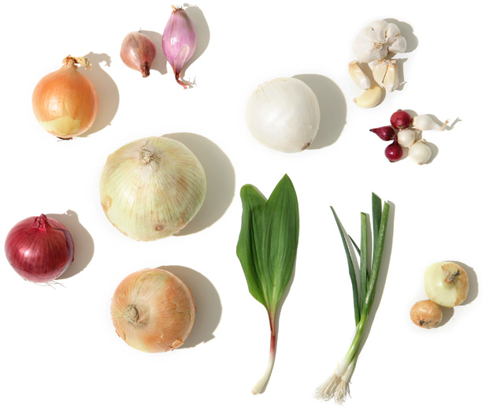
1. Spanish onion
2. Shallots
3. White onion
4. Garlic
5. Pearl onions
6. Red onion
7. Sweet onions
8. Ramps
9. Scallions
10. Cipollini
Notes:
This is a good time to discuss getting a G-mail account. You’ll need a G-mail account to access some of the course’s extra materials. One of those things we’re going to use right now. It may take a little bit of extra time for you to sign up for google, if you don’t already have a G-mail account you should do that now.
Once your account is set up, use the link below to bring up a Google draw document. See if you can match the pictures with the names of the different Alliums shown. Use the text box tool to insert numbers adjacent to the pictures that correspond to the names on the right.
https://docs.google.com/drawings/d/1WvG8dOzPFWYvWCUOHq51tcb8ZDI0L44jWITSzPWBp-g/edit?usp=sharing
See if you can identify the alliums shown. Take a few minutes, and we’ll come back and discuss them.

Slide 10
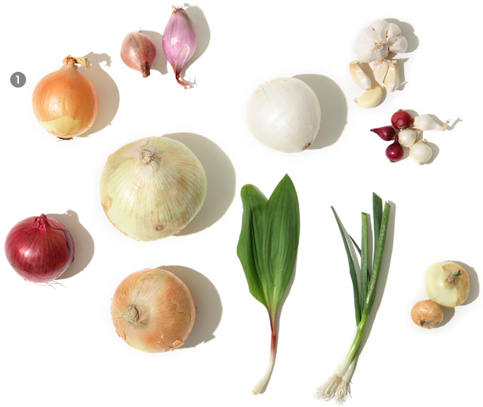
1. Spanish onion
2. Shallots
3. White onion
4. Garlic
5. Pearl onions
6. Red onion
7. Sweet onions
8. Ramps
9. Scallions
10. Cipollini
Notes:
Let’s see how you did…correct yourself as we go.
Spanish onion
This storage onion is relatively mild, but not as much as sweet onions. Round, with a thin, brownish, papery skin, Spanish onions are the most common type of onion in the United States. Pictured is a yellow Spanish onion, but they are also available as red and white. If a recipe simply calls for "an onion," a Spanish onion is the one to use.

Slide 11
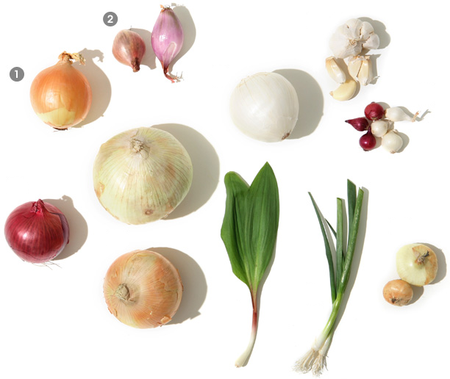
1. Spanish onion
2. Shallots
3. White onion
4. Garlic
5. Pearl onions
6. Red onion
7. Sweet onions
8. Ramps
9. Scallions
10. Cipollini
Notes:
Shallots
The shallot often looks more like garlic than an onion because of its small, bulbous cluster and thin dry coppery-brown skin. Individual shallot cloves resemble oversized garlic cloves with their pointed tapered ends, except that the shallot has a luminescent purple hue. Its flavor is milder than an onion's, but its bite is still sharp when uncooked. While the French incorporate the shallot into many dishes, it's also popular throughout southeast Asian cuisine.

Slide 12

1. Spanish onion
2. Shallots
3. White onion
4. Garlic
5. Pearl onions
6. Red onion
7. Sweet onions
8. Ramps
9. Scallions
10. Cipollini
Notes:
White onion
This storage onion is named for the color of its thin skin and flesh. With a taste that's more tangy than sweet or sour, this is the onion of choice when making Latin and Central American dishes, especially Mexican food.

Slide 13

1. Spanish onion
2. Shallots
3. White onion
4. Garlic
5. Pearl onions
6. Red onion
7. Sweet onions
8. Ramps
9. Scallions
10. Cipollini
Notes:
Garlic
A truly international vegetable, garlic is sold many ways: whole bulb, already-peeled cloves, pre-sliced, and minced. At the farmers' market, newly harvested garlic is sometimes sold with the curled green stems still attached to the bulb, the ends of which are called "scapes." An unpeeled garlic clove doesn't have a very strong scent, but once the clove's body has been damaged, a pungent odor is released. To get garlic that's sweet and fragrant, either sauté or roast it. But be careful not to burn the garlic, which will result in an acrid smell.

Slide 14

1. Spanish onion
2. Shallots
3. White onion
4. Garlic
5. Pearl onions
6. Red onion
7. Sweet onions
8. Ramps
9. Scallions
10. Cipollini
Notes:
Pearl onions
These very small onions are valued for their sweet, delicate flavor and are usually served as an accompaniment. Pearl onions can be creamed, roasted, or glazed (Italians use balsamic vinegar; Middle Easterners apply tamarind). Pickled pearl onions make a great garnish to the classic martini. And since peeling such small onions can be a chore, look for frozen pre-peeled ones at your market.

Slide 15

1. Spanish onion
2. Shallots
3. White onion
4. Garlic
5. Pearl onions
6. Red onion
7. Sweet onions
8. Ramps
9. Scallions
10. Cipollini
Notes:
Red onion
The bright reddish-purple skin makes this onion hard to miss; it's a favorite ingredient in salads. To many palates, red onions have the sharpest flavor in the family, so use uncooked red onions sparingly. To soften the taste, chill raw onions in ice water for 20 minutes before serving.

Slide 16

1. Spanish onion
2. Shallots
3. White onion
4. Garlic
5. Pearl onions
6. Red onion
7. Sweet onions
8. Ramps
9. Scallions
10. Cipollini
Notes:
Sweet onions, Fresh onion, spring onion, summer onion
This one’s tricky… there are two pictured: the Bermuda is shown above the Vidalia.
These storage onions are sweet because they have a lower concentration of sulfur allowing the sugar content to stand out. People who like onions but dislike the strong taste, will find sweet onions a good alternative. Some people even consume them raw, like ripe fruit. Besides Vidalia and Bermuda (whose name refers to a time when most onions imported to the U.S. were grown in Bermuda), other well-known sweet varieties, grown primarily in parts of the South, Southwest, and Northwest United States, include Walla Walla, Maui, Sweet Imperial, and Texas Spring Sweet. These don't keep as well as other storage onions, so try to use them up as soon as possible. It is the geography that makes them low in Sulphur. The soil…the french call it the terroire.

Slide 17

1. Spanish onion
2. Shallots
3. White onion
4. Garlic
5. Pearl onions
6. Red onion
7. Sweet onions
8. Ramps
9. Scallions
10. Cipollini
Notes:
Ramps
Also known as Tennessee truffles, wild leek, ramson, wild leek, ail des bois
This North American native spring onion is edible in its entirety, from the tops of its lily of the valley—like leaves and stems, all the way down to the bulb. Eaten raw, a ramp tastes strong and more like garlic than scallion, but if cooked, its flavor turns mildly sweet. When serving, try to keep the entire plant intact for a lovely presentation. All of the alliums are in the Lilly plant family. Do you see the family resemblance?

Slide 18

1. Spanish onion
2. Shallots
3. White onion
4. Garlic
5. Pearl onions
6. Red onion
7. Sweet onions
8. Ramps
9. Scallions
10. Cipollini
Notes:
Scallions
Green onion, bunching onion, Chinese onion, Welsh onion
This spring onion's flavorful bite makes it a popular ingredient in Asian cooking, as exemplified in the classic Korean Seafood Pancake. Some recipes may specify using only the long green hollow leaves or the white bulbous ends, but the scallion is entirely edible. Recipes usually require that scallions be chopped. Scallions are interchangeable with ramps. Don't let them languish in the fridge; use soon after purchase.

Slide 19

1. Spanish onion
2. Shallots
3. White onion
4. Garlic
5. Pearl onions
6. Red onion
7. Sweet onions
8. Ramps
9. Scallions
10. Cipollini
Notes:
Cipollini, Italian pearl onion
This Italian onion doesn't look like cousins, thanks to its flat top and squat shape, but it is growing in popularity—and availability—in the U.S. Its taste is less acrid than that of its relatives, making it ideal for creamed or glazed onions. And because of the cipollinis' size and shape, they're easy to cook and serve whole.

Slide 20
1. Spanish onion
2. Shallots
3. White onion
4. Garlic
5. Pearl onions
6. Red onion
7. Sweet onions
8. Ramps
9. Scallions
10. Cipollini
Stronger Alliums
Notes:
So let’s recap… Alliums have strong flavor. The Stronger Alliums…
Milder Alliums…

Slide 21
1. Spanish onion
2. Shallots
3. White onion
4. Garlic
5. Pearl onions
6. Red onion
7. Sweet onions
8. Ramps
9. Scallions
10. Cipollini
Milder Alliums
Notes:
Milder Alliums…We just made a classification!

Slide 22
1. Spanish onion
2. Shallots
3. White onion
4. Garlic
5. Pearl onions
6. Red onion
7. Sweet onions
8. Ramps
9. Scallions
10. Cipollini
Notes:
From what we just learned, see if you can describe some other ways to classify these? Use your Google drawing to indicate those classifications and then “share” your document with me at RwhatU8@gmail.com
Keepers or not
Bulbous or not
Cloven or not - onion’s latin root means “oneness” – probably referring to it’s one bulb in contrast to garlic’s many.

Slide 23
Other Classifications
A Discussion
Notes:
Keepers or not
Bulbous or not
Cloven or not
Sweet or not
Let’s take a break. Back in Ten minutes…

