Slide 1
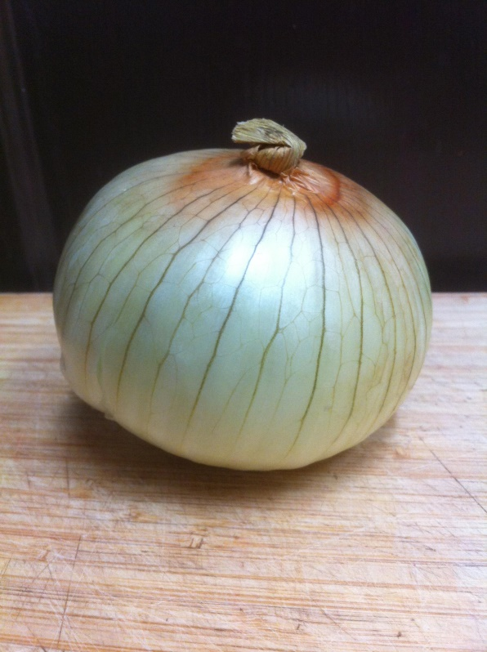
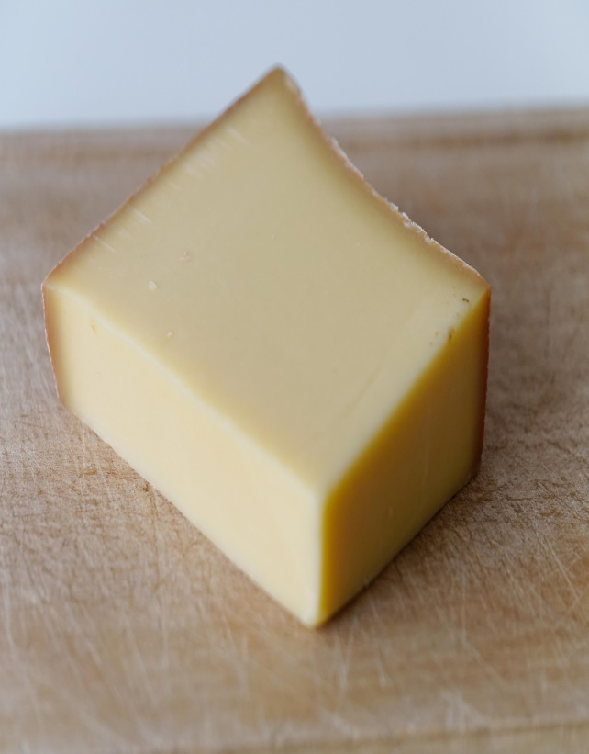
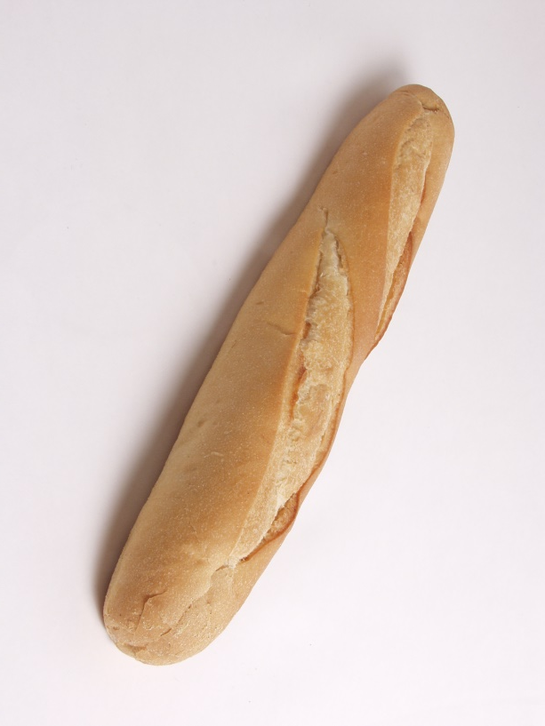
Soupe à L’Oignon
Notes:
Hi, and welcome back from the break.

Slide 2
Taxonomy not Taxidermy
- Thanks Carl.
- What do you see?
- Looking Forward.
Notes:
We’re going to talk about taxonomy now. Taxonomy is the way science classifies living things. Taxidermy is preserving dead animal skins so they look like they’re still alive. Hunters and museums often use taxidermy. The system of taxonomy that we use in science today was developed by Carl Linnaeus about 250 years ago. Let’s look at how the System Works.

Slide 3
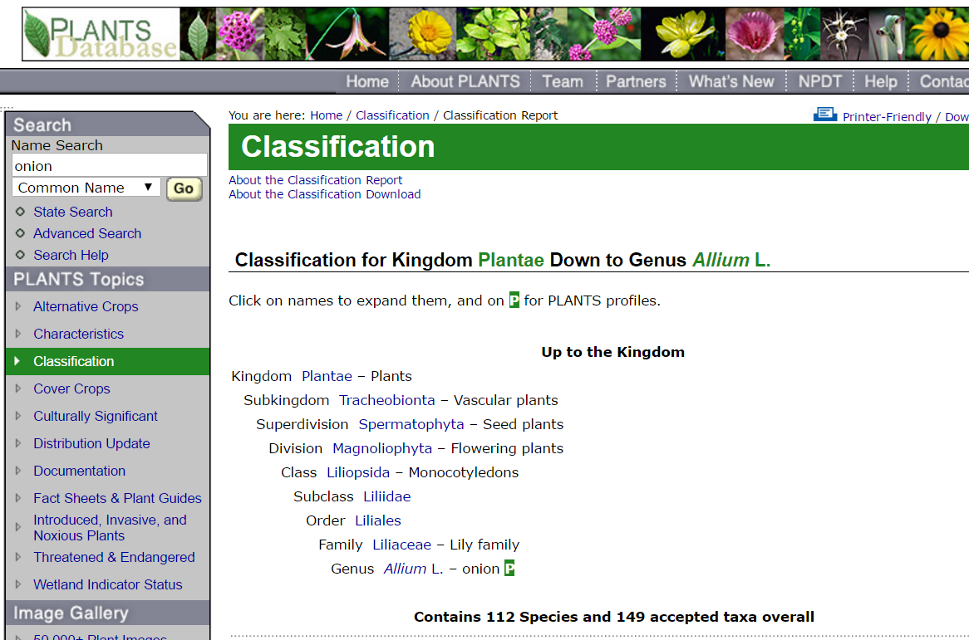
Notes:
I am going to take you to a web site set up by the U.S. Dept of agriculture. This page gives us a look at the classification for the Alliums.
http://plants.usda.gov/java/ClassificationServlet?source=display&classid=ALCE

Slide 4
Notes:
As you can see the first division is that of kingdom. In each of these cases there’s something missing. This outline shows as the answer to questions that were asked along the way. Each question has one of two answers. This is called dichotomous. Special tool called a dichotomous key is often used when classifying a plant. It is simply a series of questions with only two answers. Let’s go down the outline and see if we can figure out what the other answer was for each of these questions. Beginning with kingdom the answer to the question was plants the other answer was animals. The next level of sub kingdom, the answer was vascular plants - the other answer was non vascular plants. In the super division the answer of seed plants is opposed by plants without seeds. the Same for flowering plants - non flowering plants. Monocotyledons refers to the kind of seed that the plant has. The other answer is dicotyledon. (A bean is a good example of a dicotyledon or a “dicot” because its seed has 2/2 when you break it open.) The classification continues bringing us down to the subclass – order - family of lilies. And then finally to the genus a ALLIUM.

Slide 5
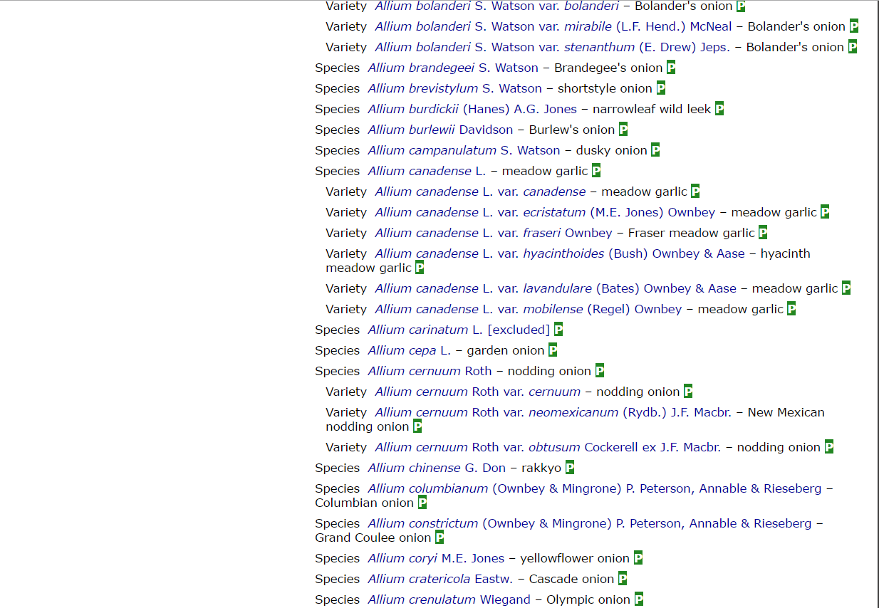
Notes:
But wait there’s more... There are hundreds of different species and varieties of alliums. We’re interested in the cooking onion.
This is a small section of the list showing Alium Cepa – the garden onion. Let’s look at three characteristics shared by all of the culinary alliums.

Slide 6
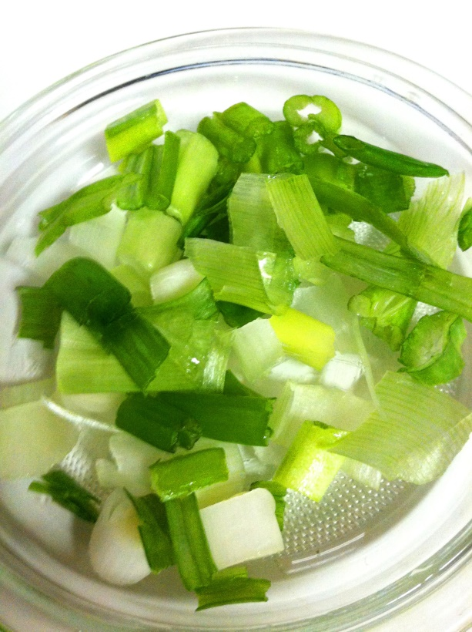
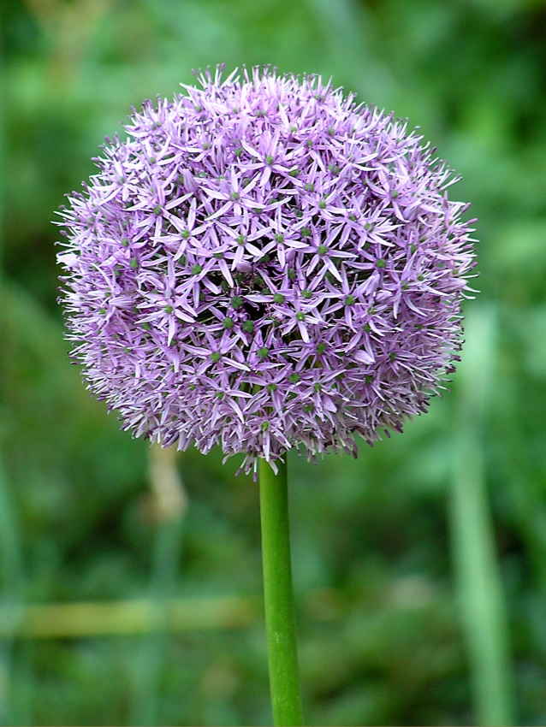
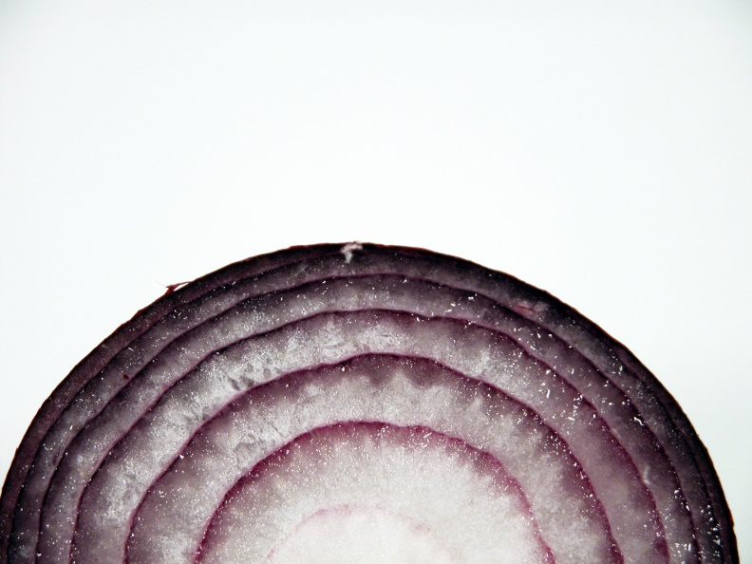
Alliums
Notes:
What do you think? I Have opened a global chat window with all of your names. Go ahead and type in which you think the unique characteristics are.
Pause here.

Slide 7
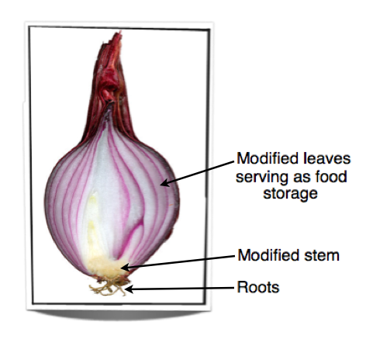
A bulb at the bottom.
.
Notes:
OK, here we have a discussion about the answers posted by the students. First we’ll discuss the most obvious characteristic of onions and other alliums. They’ll have many layers. The donkey and Schreck knew this. Cut through any alliums and you’ll find layers of modified leaves the act as Food Storage.

Slide 8

A big round ball of Flowers at the Top.
.
Notes:
Alliums have a big round ball of flowers at the top of their stems. Flowers are often used to discern between different species and varieties.

Slide 9
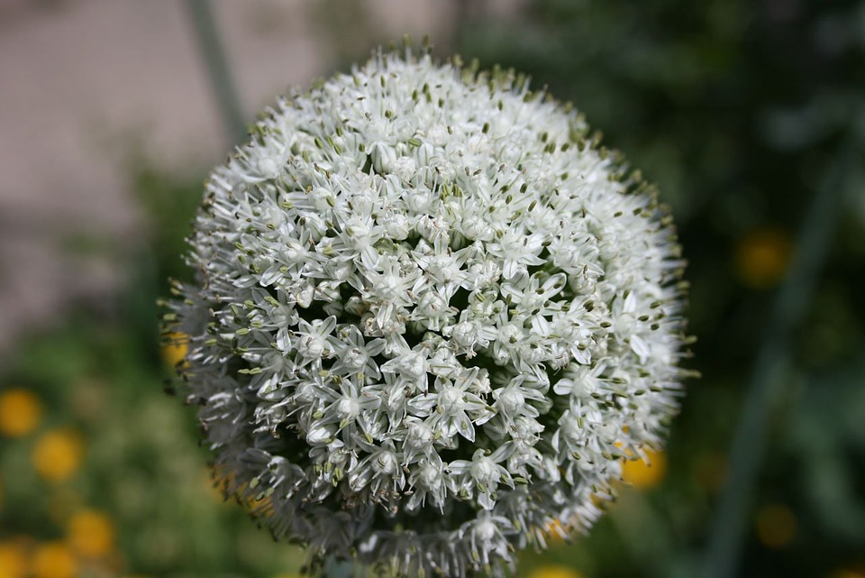

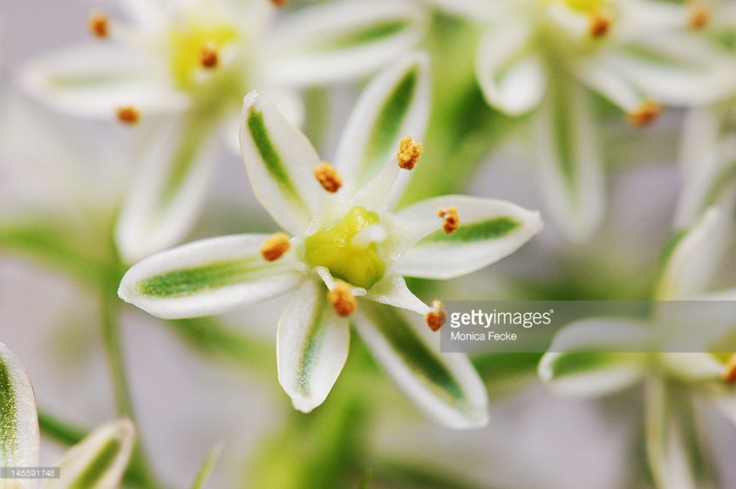
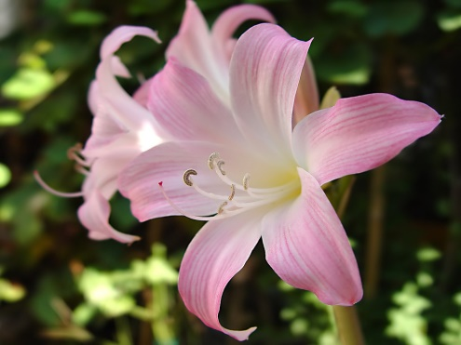
A big round ball of Flowers at the Top.
.
Notes:
If you look closely, you’ll see that this onion flower is made up of about 100 individual flowers. Those tiny flowers are each made up of six petals sepals. This is one of the distinguishing characteristics of the lily family. When you go shopping, you will likely never see your alliums flower. But this is something that botanists must be acutely aware.

Slide 10
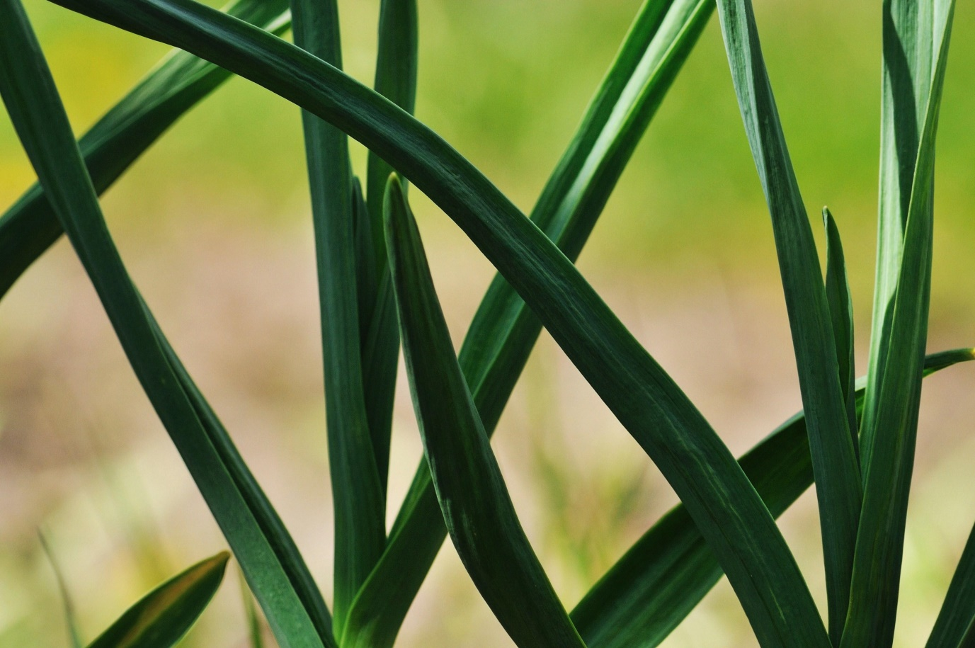
Long skinny Stem and Leaves.
.
Notes:
The third feature I want to discuss are up the Alliums long skinny stems and leaves. These are particularly obvious when you look at scallions or chives in the grocery store.

Slide 11
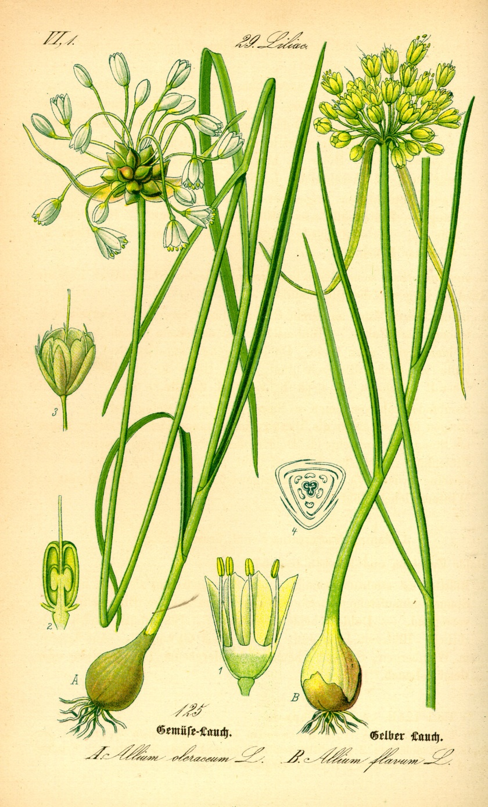
Botanical Drawing
Allium Features:
A
B
C
D – Onion?
Notes:
Botanical drawings are often used to show a plant’s distinguishing characteristics most clearly.
Tell me in the chat window what A, B and C are referring to. Describe to me how the word onion is related to the shape and of an onion.

Slide 12
Botanical Drawing
Allium Features:
Flower Head ball
Long, Skinny stems and leaves
Bulb – modified leaves
D – Onion from Latin “oneness”
Notes:
In this drawing you can see the C) bulb at the bottom, the A) flower had at the top, and the B) long skinny leaves and stem.

Slide 13
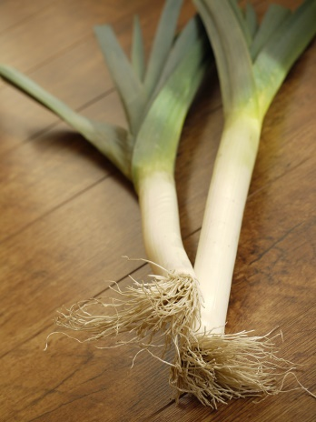
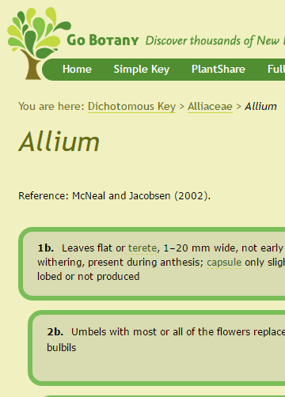
Dichotomous Key
Go to this website: https://gobotany.newenglandwild.org/dkey/allium/
Practice using the Key
Make your own Key for the Culinary Alliums we talked about.
Decide which is the best onion for soup!
Share this with me in Google Docs.
Notes:
Let’s practice using a dichotomous KEY. The dichotomous key is a series of questions with two answers. The answer leads you in a branching way to describe the plant you are looking at. Make several selections and play with a key to see how it works, then look at the 10 culinary alliums we discussed earlier, and create your own key… a set of questions that will group them into logical categories. Finally, using what we learned about the different alliums, decide which one would be best for your soup. Do this in google docs… And share your document with Me.

Slide 14
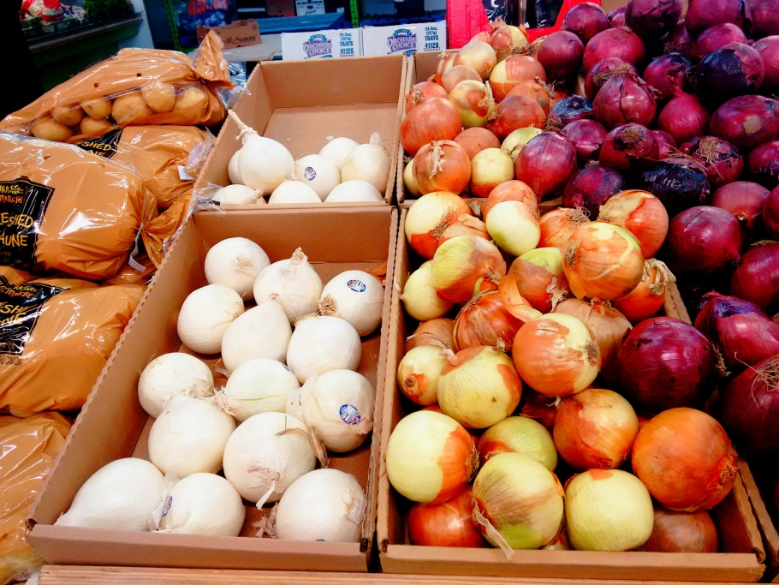
For Next Time…
Have an onion handy.

